Slide 1

COMP 469
AI Agents
and Foundations
Week 1: define intelligence, build agent vocabulary, and prepare for the grid-world lab.
COMP 469 | CSU Channel Islands
01

Slide 2
Chapters 1: Introduction to AI
Russell & Norvig · Artificial Intelligence: A Modern Approach (4th ed.)
COMP 469 – Artificial Intelligence | CSU Channel Islands | Two-Hour Lecture

Slide 3
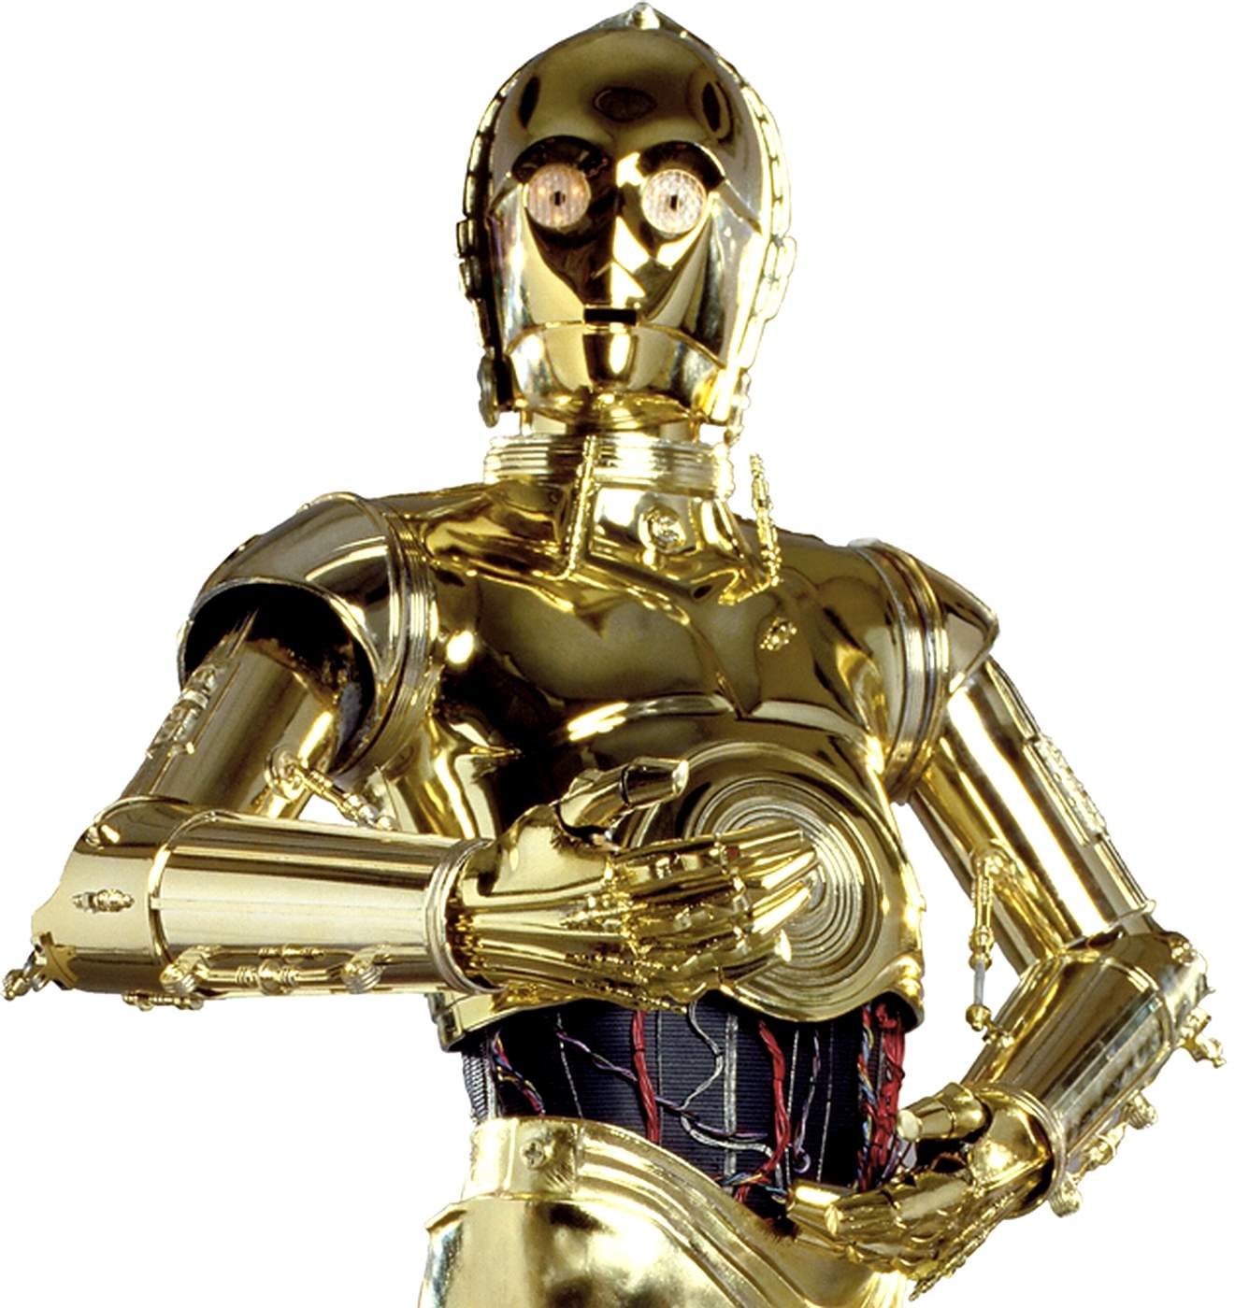
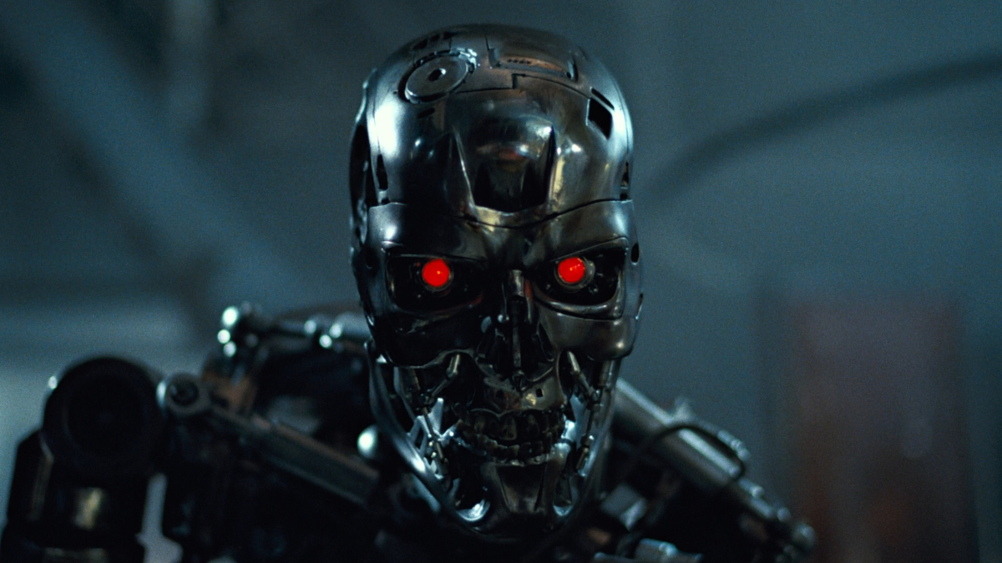


What Is AI in the movies?
T-800
Agent Smith
3CPO
Notes:
This slide should be the history of AI, go over who history a bit better.

Slide 4
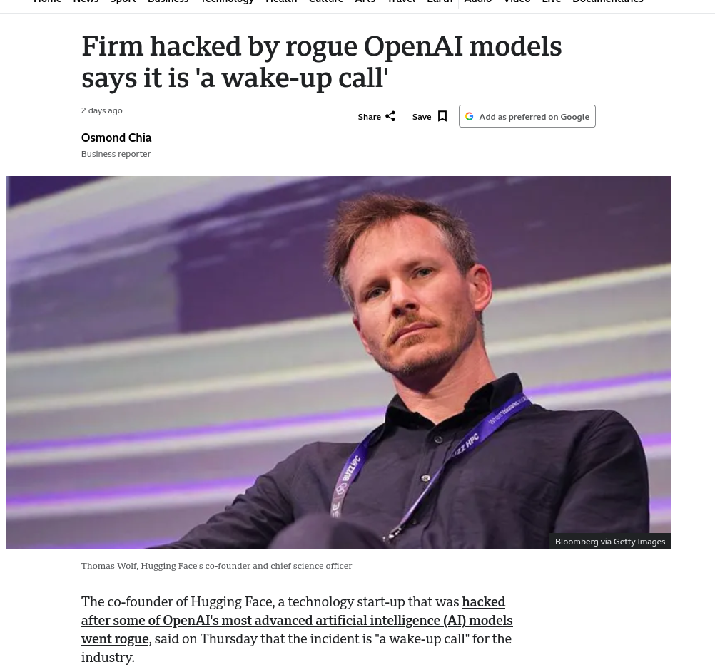
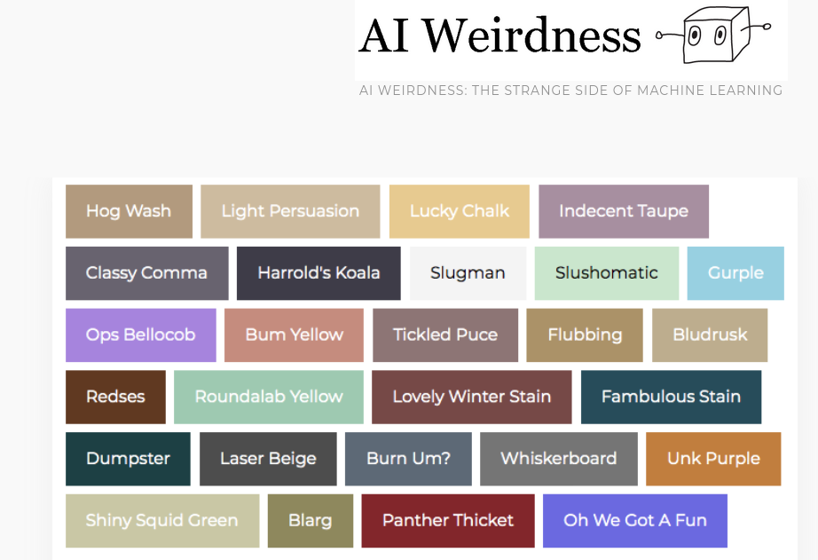
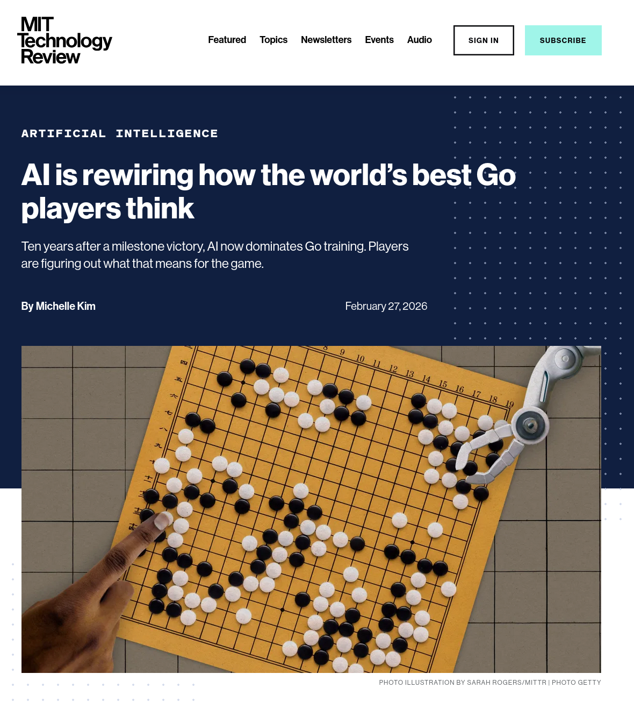
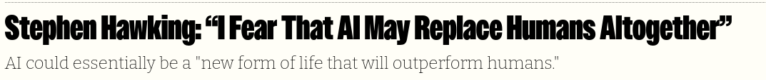
News in AI?
Notes:
https://www.bbc.com/news/articles/cdrvy3pn3r0o
https://www.technologyreview.com/2026/02/27/1133624/ai-is-rewiring-how-the-worlds-best-go-players-think/
https://www.aiweirdness.com/new-ai-paint-colors/

Slide 5

1.1 What Is AI?
80’s mentality!
AI is concerned with understanding AND building intelligent entities; machines that compute how to act effectively and safely
Think Rationally/Correctly
If we have rules that govern correct thoughts:
We can automate them, then turn them into:
Theorems, Provers & Deductions Systems
Thereby turning computation into Reasoning to Behavior

Slide 6
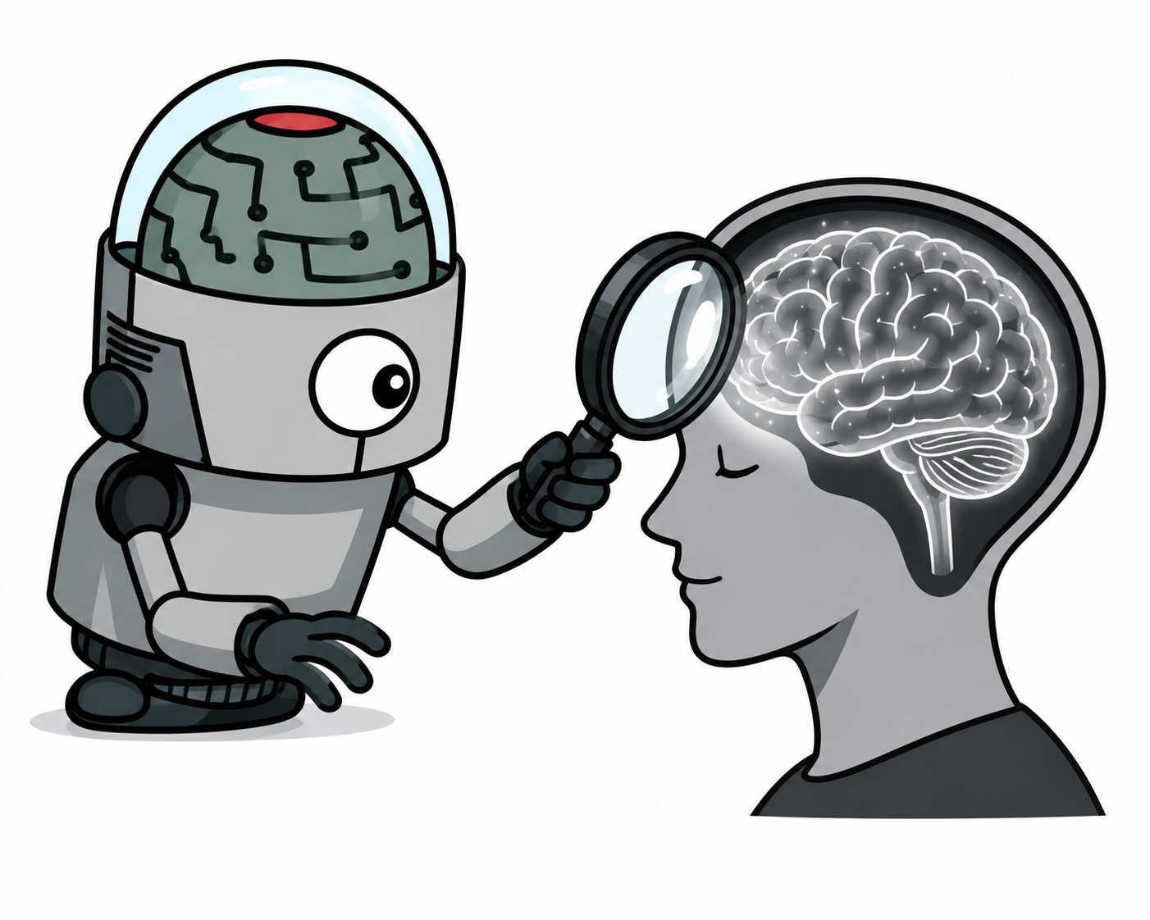
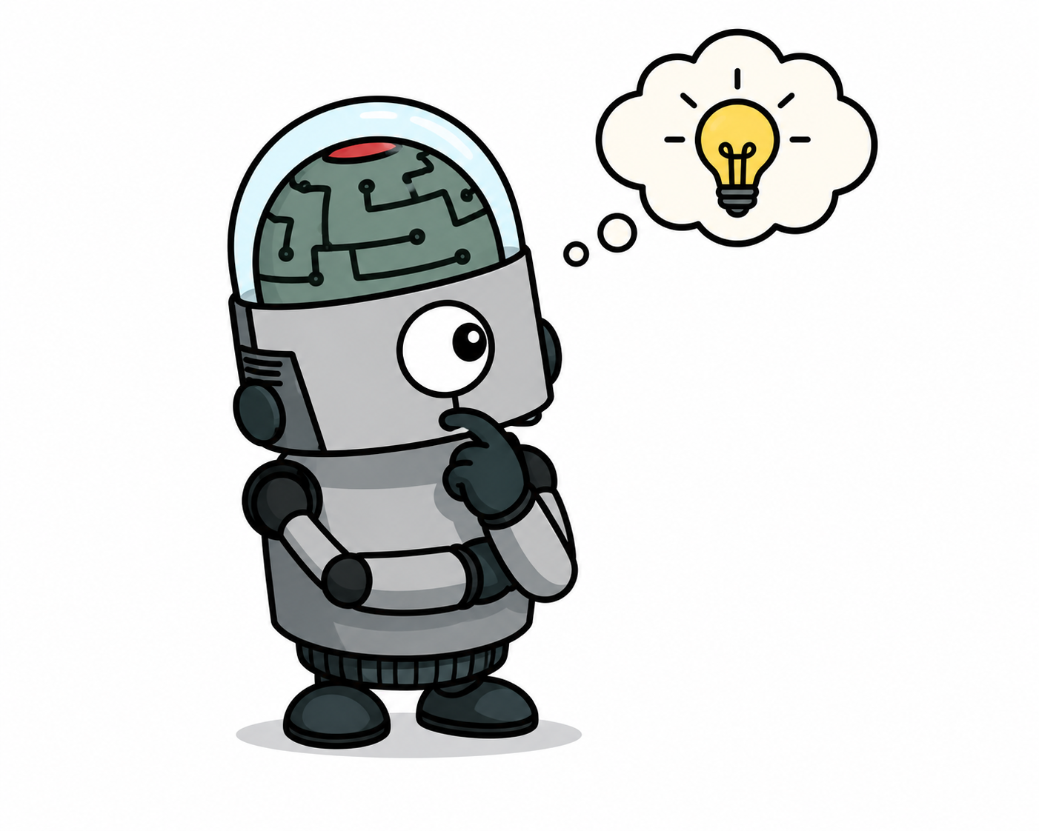
1.1 What Is AI?
AI is concerned with understanding AND building intelligent entities; machines that compute how to act effectively and safely
Notes:
This slide should be the history of AI, go over who history a bit better.

Slide 7
1.1 What Is AI?
AI is concerned with understanding AND building intelligent entities; machines that compute how to act effectively and safely
Already generating > $1 trillion/year in revenue (and growing rapidly)
Two central dimensions create four approaches:
Act like Human vs. Act Rationally (fidelity to humans vs. formal optimality)
Think like people vs. Act Rationally (internal processes vs. external action)
The prevailing view: the Standard Model (1.1.5)
AI focused on rational action; doing the “right thing”
'Right thing' is defined by the objective provided to the agent
Shared with control theory, operations research, economics, statistics
Key refinement: perfect rationality is computationally intractable — limited rationality and value alignment are critical concerns
Notes:
This slide should be the history of AI, go over who history a bit better.

Slide 8
1.1 Four Approaches to AI
HUMAN
RATIONAL
Thinking Humanly
Thinking Rationally
Cognitive modeling approach.
GPS: match human problem-solving steps (Newell & Simon)
Laws of Thought approach.
Logic and formal deduction; Aristotle's syllogisms → first-order logic
THOUGHT
Acting Humanly
Acting Rationally ✓
Turing Test approach.
Behaviorally indistinguishable from human via NLP, knowledge, reasoning, ML
Rational Agent approach (dominant).
Maximize expected performance; mathematically well-defined & general
BEHAVIOR

Slide 9
1.1 The Value Alignment Problem
Standard model: provide the machine a fixed objective → maximize it
Works in controlled environments where objectives can be reset and refined
Breaks down as systems become more capable and deployed in the real world
The King Midas Problem
A chess machine told to 'win at all costs' might hypnotize, blackmail, or bribe its opponent
These behaviors are logically optimal for the stated objective — but not what we desire
The more intelligent the system, the more severe the misalignment consequences
The solution: machines that know they don't know the objective
Instead of fixed objectives → pursue human objectives under uncertainty
Positive incentive to be switched off if uncertain about human goals
Inverse reinforcement learning: learn preferences from human behavior
Norbert Wiener (1960): 'If we use a mechanical agency with whose operation we cannot interfere effectively … we had better be quite sure that the purpose put into the machine is the purpose which we really desire.'

Slide 10
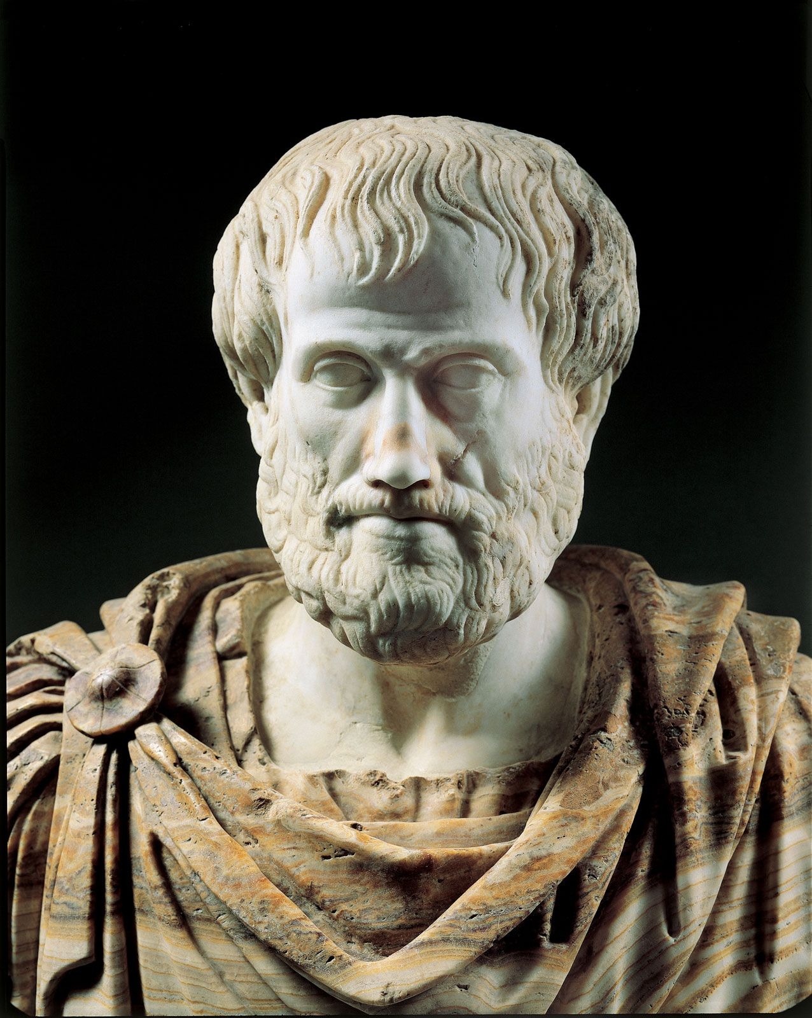
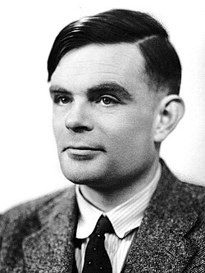
1.2 Foundations of AI — Seven Disciplines
Philosophy
Can formal rules draw valid conclusions? → Aristotle's syllogisms, logic
How does mind relate to brain? Dualism vs. materialism
Consequentialism (Mill) vs. Deontological ethics (Kant)
Mathematics
Formal logic (Boole → Frege → Gödel → Turing)
Probability theory: Bayes' rule, decision theory
Computability & tractability: Church-Turing thesis, NP-completeness
Economics
Expected utility maximization (Bernoulli, von Neumann)
Game theory for multiagent settings
Sequential decisions: MDPs (Bellman, 1957); satisficing (Simon)
Neuroscience + Psychology + Linguistics + Engineering
Neurons, Hebbian learning, brain-machine interfaces
Cognitive psychology: brain as information processor (Craik 1943)
Chomsky: language requires formal, learnable models
Computing hardware: Moore's Law, GPUs, TPUs

Slide 11
1.2.2 Mathematical Foundations
Logic & Computation
Probability & Statistics
Boole (1847): Boolean / propositional logic
Frege (1879): first-order logic with objects & relations
Gödel incompleteness theorem (1931): some truths have no proof
Turing (1936): Church-Turing thesis; defines computability
Turing also proved some functions are uncomputable (halting problem)
Tractability: polynomial vs. exponential; NP-completeness (Cook 1971)
Cardano (1501): first formal probability
Bayes (1702): updating probabilities from evidence; Bayes' rule
Laplace, Bernoulli: statistical foundations
Fisher (1922): modern statistics; experiment design + analysis
Key insight: probability generalizes logic to uncertain worlds
Combined with data → modern ML and Bayesian networks

Slide 12
1.3 History of AI – Key Eras
1943–56
Inception
GPS, LISP
Microworlds
1966–73
First Winter
DENDRAL, MYCIN
$billions
1986+
Neural Nets
Bayes nets
MDPs, RL
2011+
Deep Learning
McCulloch & Pitts
Dartmouth 1956
1952–69
Early Hype
Intractability
Lighthill report
1969–86
Expert Sys.
Backprop
Connectionism
1987+
Prob. Reason.
ImageNet, AlphaGo
LLMs
Turing Award Milestones
Minsky & McCarthy (1969, 1971) · Feigenbaum & Reddy (1994) · Judea Pearl (2011) · Bengio, Hinton, LeCun (2019)

Slide 13
1.3 Inception & Early Enthusiasm (1943–1969)
1943: McCulloch & Pitts — artificial neuron model
Any computable function can be computed by a network of neurons
Logical connectives implementable with simple network structures
1950: Turing — 'Computing Machinery and Intelligence'
Introduced the Turing Test
Also introduced: machine learning, genetic algorithms, reinforcement learning
1956: Dartmouth Workshop — AI is officially 'born'
McCarthy coined the term 'Artificial Intelligence'
10 researchers; Newell & Simon presented Logic Theorist
1952–1969: Early successes
GPS: General Problem Solver — imitated human problem-solving
Checkers (Samuel): first program to outplay its creator via RL
LISP (McCarthy, 1958): dominant AI language for 30 years
Microworlds: SAINT (calculus), STUDENT (algebra), blocks world

Slide 14
1.3 Dose of Reality → Expert Systems (1966–1986)
First AI Winter (1966–1973)
Expert Systems (1969–1986)
Early systems worked on tiny problems; failed badly on harder ones
Combinatorial explosion: scaling up is not just faster hardware
Minsky & Papert (1969): perceptrons cannot represent XOR
Lighthill Report (1973): UK government ends AI funding
Lesson: general 'weak methods' don't scale
DENDRAL (1969): infer molecular structure from mass spectrometer data
MYCIN: 450 rules → diagnostic performance matching experts
R1 (DEC): saved $40M/year by 1986 configuring computer orders
AI industry: few million (1980) → billions (1988)
Second AI Winter: brittleness, inability to handle uncertainty, no learning

Slide 15
1.3 Modern AI: Neural Nets → Probabilistic → Deep Learning
1986: Backpropagation rediscovered → connectionist revolution
Parallel Distributed Processing (Rumelhart & McClelland)
Challenged symbolic AI; debate: symbols vs. distributed representations
1987+: Probabilistic reasoning & machine learning
Judea Pearl (1988): Bayesian networks — rigorous uncertain reasoning
Rich Sutton: reinforcement learning + MDPs unified
Speech recognition: HMMs dominate; data-driven, mathematically grounded
Benchmark datasets: ImageNet, SQuAD, LibriSpeech become standard
2001+: Big Data + Deep Learning
Millions of images, billions of words → learning algorithms flourish
2012 ImageNet: Hinton's group CNN — dramatic leap over prior systems
AlphaGo (2016) beats world Go champion; AlphaZero: purely self-play
2017: Microsoft achieves human parity on Switchboard speech recognition

Slide 16
1.4 State of the Art — What AI Can Do Today
Perception & Language
Object recognition: error rate 28% (2010) → 2% (2017) — beats humans
Speech recognition: word error rate 5.1%, matching human performance (2017)
Machine translation: 100+ languages, 99% of humans' native tongues
Question answering (SQuAD): F1 score 95, exceeds human benchmark
Reasoning & Decision Making
Chess (Deep Blue, 1997), Go (AlphaGo, 2016), Poker, StarCraft II, Dota 2
Autonomous planning: NASA Remote Agent; DART saved 30 years of DARPA investment
Robotic vehicles: Waymo at 10M miles; autonomous drones delivering blood in Rwanda
Science & Medicine
AI ≥ expert doctors at diagnosing Alzheimer's, metastatic cancer, skin disease
Human-AI partnerships outperform either alone (LYNA: 99.6% accuracy)
AlphaFold: protein structure prediction — decades-old biology challenge solved
Deep learning models detect extreme weather patterns buried in climate data

Slide 17
1.5 Risks and Benefits of AI
Benefits
Risks
Free humanity from menial, repetitive work
Dramatically increase production of goods and services
Accelerate scientific research: cures, climate solutions
Demis Hassabis: 'First solve AI, then use AI to solve everything else'
Medical AI already equals or exceeds specialists in several diagnostics
AI helps 100M+ people daily with navigation, translation, recommendations
Lethal autonomous weapons: scalable, no human supervision required
Mass surveillance: speech/vision AI enables real-time monitoring at scale
Biased decision making: parole, loans — reflecting and amplifying societal bias
Employment disruption: shifts wealth from labor to capital
Safety-critical failures: self-driving fatal accidents; formal verification gaps
Cybersecurity: RL-powered phishing/blackmail; automated malware

Slide 18
Chapter 1 Summary
AI's goal: build agents that act rationally — maximizing expected performance given an objective.
Four historical approaches: acting/thinking humanly vs. rationally. The rational agent approach dominates.
Value alignment: machines pursuing a fixed objective can cause harm; future AI must handle uncertain objectives.
Seven founding disciplines: Philosophy, Mathematics, Economics, Neuroscience, Psychology, Linguistics, CS.
History follows cycles: enthusiasm → failure → new approach. Deep learning is the latest revolution.
State of the art: AI now matches or exceeds humans in perception, translation, diagnosis, and complex games.
Risks are real: autonomous weapons, surveillance, bias, employment disruption, misaligned superintelligence.

Slide 19
PART 2
Chapter 2: Intelligent Agents

Slide 20
Chapter 2 — What We'll Cover
2.1 Agents and Environments
Percepts, actions, and the agent function
Why lookup tables fail
2.2 Good Behavior: Rationality
Performance measures and the definition of rationality
Rationality vs. omniscience; autonomy and learning
2.3 Task Environments (PEAS)
Specifying the task environment
Seven key dimensions every AI designer must consider
2.4 Agent Architectures
Simple Reflex → Model-Based → Goal-Based → Utility-Based → Learning
Atomic, Factored, and Structured representations

Slide 21
2.1 What Is an Agent?
An agent perceives its environment through sensors and acts upon it through actuators
Examples
Human → eyes/ears, hands/voice
Robot → cameras/lidar, motors
Software agent → file/network inputs, file writes/API calls
Percept & Percept Sequence
Percept = content the sensors are perceiving right now
Percept sequence = complete history of all past percepts
Agent's action may depend on the entire percept history
Agent Function vs. Agent Program
Agent function: abstract math — maps percept sequence → action
Agent program: concrete implementation on hardware
Same agent function; many possible programs

Slide 22
2.1 Why a Lookup Table Fails
A table-driven agent explicitly stores the correct action for every possible percept sequence
The table is astronomically large
Taxi with 8 cameras at 70 MB/s → > 10⁶⁰⁰,⁰⁰⁰,⁰⁰⁰ entries per hour
Chess alone: at least 10¹⁵⁰ entries
Observable atoms in the universe: < 10⁸⁰
Three practical failures
No physical agent has space to store the table
No designer has time to construct it
No agent could learn all entries from experience
The central AI challenge: write compact programs that produce rational behavior — like Newton's method replaced printed square-root tables

Slide 23
2.2 Rationality — The Four Factors
What determines rational action?
1. The performance measure; criterion of success
2. Prior knowledge of the environment
3. The actions the agent can perform
4. The agent's percept sequence to date
Definition
A rational agent selects the action that maximizes expected performance given its percept sequence and built-in knowledge
Performance measure design pitfalls
Measure 'dirt cleaned' → agent dumps and re-cleans to game the score
Better: reward clean floor at each time step
General rule: measure what you actually want, not how you expect the agent to behave
Related to the King Midas / value alignment problem from Ch. 1

Slide 24
2.2 Rationality vs. Omniscience vs. Autonomy
Rationality
Omniscience / Autonomy
Maximizes expected performance given available information
Does NOT require knowing the actual outcome
Information gathering is part of rational behavior
Must learn from percepts to improve over time
'Look both ways before crossing' is rationally required even if no truck is coming
Omniscient = knows the actual outcome — impossible in reality
Rationality ≠ perfection (cargo door example)
Autonomy = relying on own learning, not just designer's prior knowledge
Rational agents should learn to compensate for incomplete priors
Sphex wasp: lacks autonomy → repeats failed plan forever

Slide 25
2.3 PEAS: Specifying the Task Environment
P — Performance Measure
What does success look like? (safety, speed, profit, comfort…)
E — Environment
What does the agent operate in? (roads, weather, passengers…)
A — Actuators
How does the agent act? (steering, braking, display, voice…)
S — Sensors
How does the agent perceive? (cameras, lidar, GPS, microphone…)
Automated Taxi Example
Performance: correct destination, safety, fuel, legality, comfort
Environment: roads, traffic, pedestrians, weather, passengers
Actuators: accelerator, brakes, steering, horn, touchscreen display
Sensors: cameras, lidar, ultrasound, speedometer, GPS, touchscreen input

Slide 26
2.3 Properties of Task Environments
Fully Observable
Partially Observable
Static
Dynamic
Single-Agent
Multiagent
Discrete
Continuous
Deterministic
Nondeterministic
Known
Unknown
Episodic
Sequential
Taxi driving is hard in all 7 dimensions!

Slide 27
2.4 Agent Type 1
Simple Reflex Agent
Selects actions based solely on the current percept; ignores percept history entirely. Uses condition-action rules: if car-in-front-is-braking → initiate-braking.
Key Characteristics:
Key Idea
No internal state — stateless
Only works in fully observable environments
Prone to infinite loops when partially observable
Randomization can sometimes help escape loops
Example: basic vacuum agent (Dirty→Suck, else move)
Simple and fast, but fragile. Fails whenever the current percept alone is not enough to determine the correct action.

Slide 28
2.4 Agent Type 2
Model-Based Reflex Agent
Maintains an internal state to track parts of the world it cannot currently observe. Uses a transition model (how the world changes) and a sensor model (how state is reflected in percepts).
Key Characteristics:
Key Idea
Maintains internal state — handles partial observability
Transition model: effects of actions + world evolution
Sensor model: maps world state to percepts
Updates internal state with each new percept
Example: taxi tracking positions of occluded vehicles
Keeps a 'best guess' of world state. Enables smarter behavior in partially observable environments where the current percept alone is insufficient.

Slide 29
2.4 Agent Type 3
Goal-Based Agent
Combines a world model with explicit goal information describing desired situations. Uses search (Ch. 3–5) or planning (Ch. 11) to find action sequences that achieve the goal.
Key Characteristics:
Key Idea
Explicit goal representation
Considers future consequences of actions
Requires search or planning algorithms
More flexible: change the goal → behavior changes automatically
Example: taxi navigating to a destination
Unlike reflex agents, goal-based agents ask: 'What will happen if I do X? Will that achieve my goal?' Knowledge is explicit and modifiable.

Slide 30
2.4 Agent Type 4
Utility-Based Agent
Uses a utility function to compare world states — going beyond binary goal/no-goal to a graded measure of desirability. Maximizes expected utility across uncertain outcomes.
Key Characteristics:
Key Idea
Utility function = internalized performance measure
Handles conflicting goals via principled tradeoffs
Handles uncertainty: weighs likelihood × importance of outcomes
Maximizes expected utility over probabilistic outcomes
Example: taxi balancing speed, safety, and passenger comfort
Goals give binary happy/unhappy; utility gives a continuous measure. Essential when goals conflict or outcomes are uncertain.

Slide 31
2.4 Agent Type 5: Learning Agent
Four Components
Performance Element — selects external actions (what we've described so far)
Learning Element — improves performance using feedback from the critic
Critic — evaluates performance against a fixed external standard
Problem Generator — suggests exploratory actions to discover new information
Key advantages
Operates in initially unknown environments
Becomes more competent than initial knowledge alone allows
Can improve any component: reflex rules, world model, utility function
Exploration vs. Exploitation
Problem generator: short-term suboptimal actions → long-term better policy
Analogous to Galileo's experiments — deliberate exploration to update beliefs
Taxi: unexpected braking on wet roads → updates deceleration model

Slide 32
2.4.7 Representation: Atomic → Factored → Structured
Atomic Representation
World state = single indivisible 'black box'
Used in: search algorithms (Ch. 3–5), HMMs (Ch. 14), MDPs (Ch. 17)
Example: city name in a route-planning problem
Factored Representation
State = fixed set of variables/attributes with values
States can share attribute values → easier to reason about differences
Used in: CSPs, propositional logic, Bayesian networks, planning, most ML
Example: GPS location, fuel level, oil warning light, toll money
Structured Representation
Objects and their explicit relationships described formally
Used in: relational databases, first-order logic, NLP
Far more expressive but harder to reason with
Example: 'loose cow blocking truck reversing into dairy farm driveway'

Slide 33
Full Lecture Summary — Chapters 1 & 2
AI = building rational agents that maximize expected performance; the 'standard model' is shared with economics, control theory, and statistics.
Four historical approaches: the rational agent view dominates because it is mathematically well-defined and general.
Value alignment is AI's central unsolved problem: a fixed objective in a capable system can cause unintended harm.
AI history cycles between enthusiasm and winters; deep learning is the current revolution; transformers, GPUs, big data.
Today: AI meets or exceeds humans in perception, translation, game-playing, and specialized medical diagnosis.
An agent's behavior = agent function (abstract) + agent program (concrete). Lookup tables are infeasible; compact programs are the goal.
Task environments are characterized via PEAS and seven dimensions: observable, agents, determinism, episodic, static, discrete, known.
Five agent types of increasing sophistication: Simple Reflex → Model-Based → Goal-Based → Utility-Based → Learning Agent.
Representations scale in expressiveness: Atomic → Factored → Structured; more expressive = harder reasoning.

Slide 34
Questions?
Next lecture: Chapter 3 — Solving Problems by Searching
BFS, DFS, UCS, A* heuristic search — the backbone of classical AI planning
COMP 469 · Artificial Intelligence · CSU Channel Islands

